Slide 1




Breaking the ice with Pester for PowerShell tinkerers
@codaamok

Slide 2


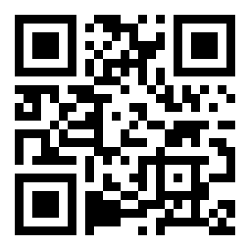
About me 🙃
Adam Cook (Southampton, UK)
Support Engineer at Patch My PC
PowerShell, ConfigMgr, and Azure (and WSUS )
Blog
SysManSquad – https://sysmansquad.com
Adam Cook https://adamcook.io
PowerShell Southampton user group
https://pssouth.co.uk
Scan to get deck content
acook.io/presentations

Slide 3
About the session
~1 hour
Get all content from https://acook.io/presentations
Breaking the ice with Pester
Why you should use it
How it fits into a pipeline
Demos
You need:
Some experience with PowerShell
Some git knowledge is ideal but not essential
Zero knowledge of Pester 🙂
Scan to get deck content
acook.io/presentations

Slide 4
History of Pester
Born by Scott Muc (@scottmuc) in 2011
Primarily maintained today by Jakub Jareš (@nohwnd)
Came shipped with Windows in 2015
Scan to get deck content
acook.io/presentations
Notes:
Came with Windows in 2015
- First open-source project to be shipped with Windows
- This caused problems when maintainers changed and the signature used to sign the module changed

Slide 5

Notes:
Pester is a fantastic tool that will leap you and your code forward!

Slide 6
Why? 🤔
Survival
Sharing and fostering contribution
JFDI and focus
No more recurring bugs
Test infrastructure and/or services!
Scan to get deck content
acook.io/presentations
Notes:
Ideal for code if you:
want to survive a long time
share with others and encourage contribution
manage multiple projects and do not need to remember every inner working detail all the time
JFDI your work and let the tests prove you wrong
do not want bugs do not reappear!
test infrastructure or services!
Why do I learn it?
Felt like ‘hotness’
However, the more I learned about the value of testing code, the more I wanted it
Talk about PSShlink: its API changes frequently

Slide 7
All you need to know ^{(right now} 😉 ⁾
Three functions:
Describe [-Name] <String> [-Fixture] <ScriptBlock>
It [-Name] <String> [-Test] <ScriptBlock>
Should lots of parameters!
Describe "Get-WinAdminsMembers" {
It "Should not be null or empty" {
Get-WinAdminsMembers | Should -Not -BeNullOrEmpty
}
}
Describe "Get-WinAdminsMembers" {
It "Should not be null or empty" {
Get-WinAdminsMembers | Should -Not -BeNullOrEmpty
}
}
Notes:
There are more than just 3, and there’s more
A framework with its own DSL that resembles syntax like another testing framework from Ruby
Order is key: should > it > describe
Describe:
Describe the ‘subject’ of the test, i.e. the target. e.g. a function, script, or server name
Every test file needs at least one
Contains It blocks
It:
Describe the test case itself, ie describe the act you are about to perform
Can have infinite number of test cases within a Describe block
Contains executable code and one or more assertions should ‘Should’
Should:
Is an assertion
Takes data from pipeline
Use many of the available operators available

Slide 8

Demo 🤞
Notes:
Get-WinAdminsMembers.Tests.ps1
BeforeAll { }
Walk through different Should parameters
Infrastructure.Tests.ps1
Add another IP and go into –TestCases
Fake code checking services on a domain controller
Invoke-MyTests.ps1
PesterConfiguration object
Throw on test fail
Ideal if want to script remediation or alerting
Not great if want to parse test results
But… parse XML! $Config.TestResult.Enabled

Slide 9
CI/CD Pipeline 🚀
Continuous Integration and Continuous Deployment / Delivery
Pipeline
CI
CD
Make change to code, check it in to source control
Build
Test
Deploy to production
Scan to get deck content
acook.io/presentations
Notes:
Discuss concept
Walk through the stages
Making tests the yay/nay factor for release is love

Slide 10

Demo 🤞
Notes:
breaking-the-ice-with-pester.yml
PSShlink

Slide 11
“Acceptance” and “Unit” tests
Acceptance testing
Can be described as ‘black box’ or ‘functional’ testing
Use it like your users
Assumption of no understanding for inner workings of the code
Unit testing
Can be described as ‘clear box’ testing
Intent is to test specific internal structures of your code
Have clear and thorough understanding of the code
Scan to get deck content
acook.io/presentations
Notes:
Discuss how this relates to things like modules

Slide 12
Real world examples
Rob Sewell (@sqldbawithbeard) blogs on querying SQL servers with sa account enabled, and writing Pester tests which reports on a SQL server conforming to this test
https://sqldbawithabeard.com/2017/11/16/write-your-first-pester-test-today/
Recently implemented acceptance tests as part of my CI/CD pipeline for a module I maintain
https://github.com/codaamok/PSShlink/tree/main/tests
Scan to get deck content
acook.io/presentations

Slide 13
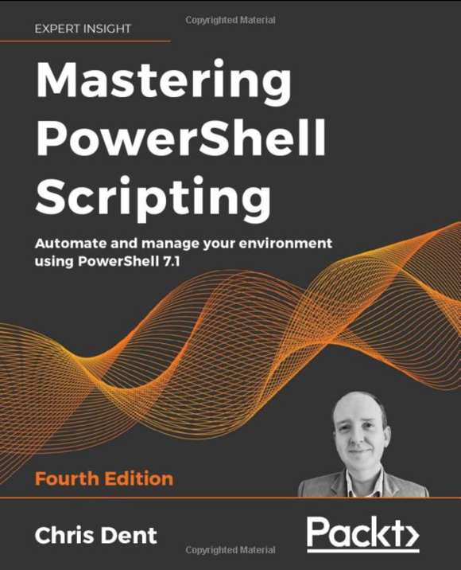
Final comments
Docs
https://pester-docs.netlify.app
YouTube playlist:
https://acook.io/pesterplaylist
Mastering PowerShell Scripting
https://www.amazon.co.uk/Mastering-PowerShell-Scripting-Automate-environment/dp/1800206542
❤️
Scan to get deck content
acook.io/presentations
Notes:
There’s a lot more to Pester than what I’ve shown you
More features available as you learn more

